Slide 1


Team No. NWB Subject : Cyber Security and Digital Forensics
Linux Forensics Fundamentals
AUCEA, DEPT of CSSE 4/6 CSNW
Notes:
ID=d924773e-9a16-4d6d-9803-8cb819e99682 Recipe=text_billboard Type=TextOnly Variant=0 FamilyID=AccentBoxWalbaum_Zero

Slide 2











Team Members
Aashish Ojha Kumar (317506408001)
Arshatullah Mohammed
317506408005
Bindu Priya Bugatha
317506408007
Dakshit Raj Pediredla
317506408009
Mona Choudhrani
317506408024
Sai Abhiram E
317506408039
Sandeep T
317506408044
Satya Venkata Lakshmi Supriya Ch
317506408046
Sri Rammanikanta G
317506408050
Uma Basaveswara Rao Kurra
317506408055
Veda Upasan P
317506408057

Slide 3

Problem Statement
Memory acquisition in LINUX system
On a partition-hard disk using fdisk command
On volatile memory using LiME tool

Slide 4
INTRODUCTION

Slide 5
fdisk
Format disk
Dialog-driven command in Linux
Only root or users with sudo privileges can manipulate
fdisk –h, fdisk –l, fdisk -w
Allows a user to
Create space for new partitions
Organizing space for new drives
Re-organizing old drives
Copying, moving data to new disk partitions

Slide 6
LiME
Loadable Kernel Module / Linux Memory Extractor
Captures volatile memory from a running Linux device
Digital investigations can performed without interrupting main memory
Minimize its interaction between user & kernel space processes during acquisition
Unique feature: capture memory from android devices
LiME utilizes the insmod command to load the module

Slide 7


TOOLS USED
Linux System (UBUNTU)
LiME (Linux Memory Extractor) Tool
Hashing Tools

Slide 8
PROCEDURE & RESULTS

Slide 9
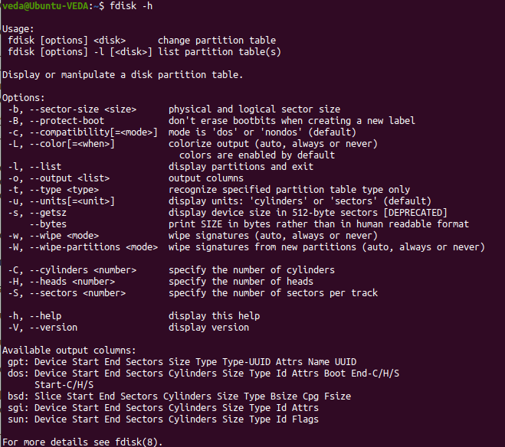
For creating memory image of Disk
Open the Terminal.
Use fdisk -h command for help message and listing of all options.

Slide 10
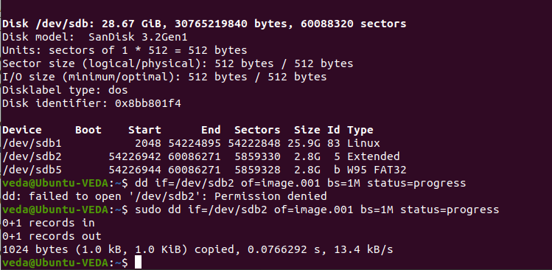
Contd.
Use fdisk -l to list the partitions on the system
Create a memory image of a disk partition with dd command.
Purpose is to convert and copy files

Slide 11
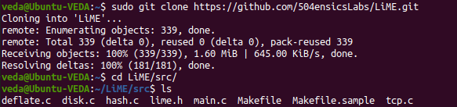
For creating memory image of Volatile memory
RAM
Clone the LiME tool from GitHub.
Change directory from home to /LiME/src/

Slide 12
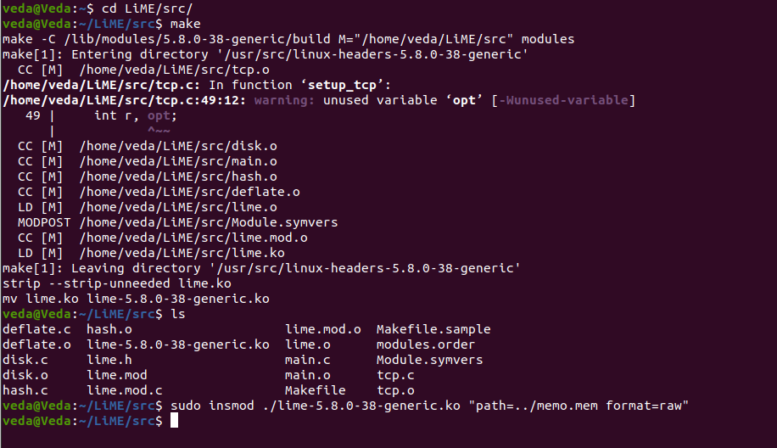
Contd.
Using make Command create the kernel object.

Slide 13
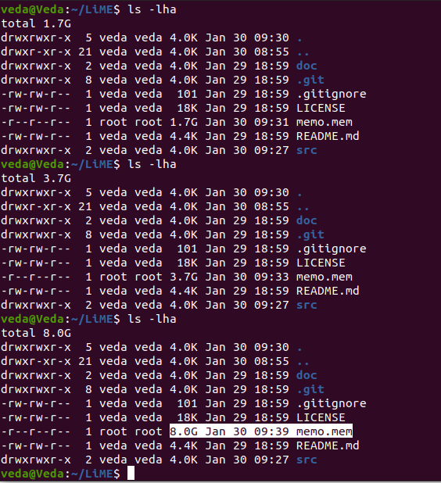
Contd.
Now create the memory image .

Slide 14
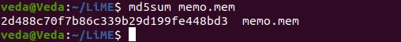
Contd.
Using hashing methods generate a hash value

Slide 15
CONCLUSION
Forensics professional should use these methods to investigate and identify attacks or malicious behaviors that do not leave detectable traces on hard drive. For further analyzing of the memory files, some tools like FATKit, WMFT, Volatility Framework must be used.

Slide 16
WEB RESOURCES USED
https://www.oreilly.com/library/view/the-art-of/9781118824993/c04.xhtml
https://en.wikipedia.org/wiki/Fdisk
https://www.youtube.com/watch?v=_7Tq8dcmP0k
https://www.sans.org/reading-room/whitepapers/forensics/techniques-tools-recovering-analyzing-data-volatile-memory-33049

Slide 17


